Slide 1
Managing Staffing Inefficiencies Using Analytics
BA638 – Team 2 Ravi Bandi
Khanh Dang
Hien Do

Slide 2
01
02
Agenda
03
04
Business Problems
Objective
Analysis & Results
Recommendations

Slide 3




Business Problem
Sales representative are underutilized
Operational process
Longer to proceed customer’s request
Customers do not answer the phone
Sales revenue
Trust Issues
Unable to identify potential customers
Start-up company

Slide 4





Stakeholders
Management
Target customers
Sales representatives
and Staff
Financial Institutions
Data Analyst

Slide 5

Objective
Optimizing employee schedule to resolve underutilization
Improving customer onboard processing
Identifying potential customers
Improving operational process to enhance customers’ satisfaction

Slide 6
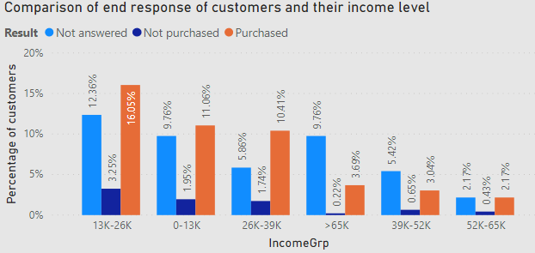
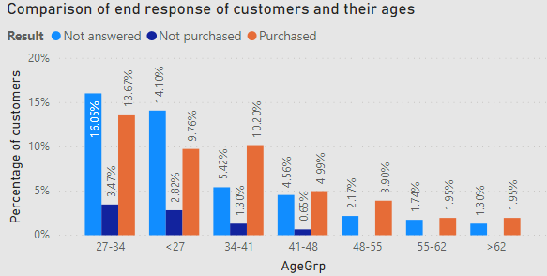
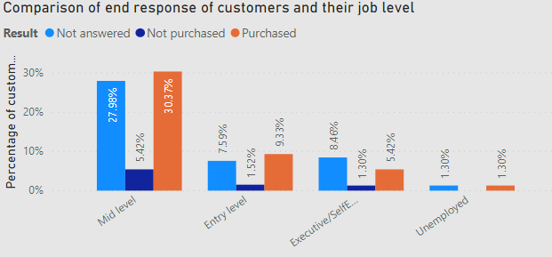
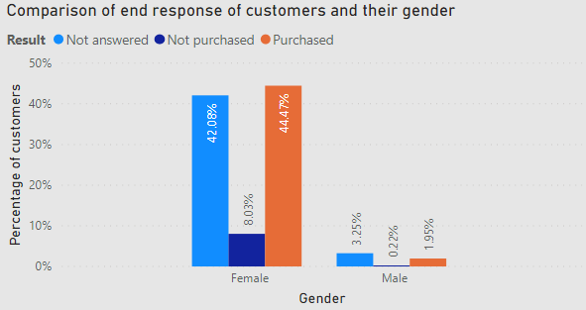
Analysis & Results
Customers’ demography

Slide 7
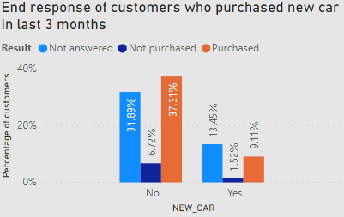
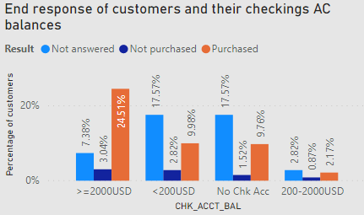
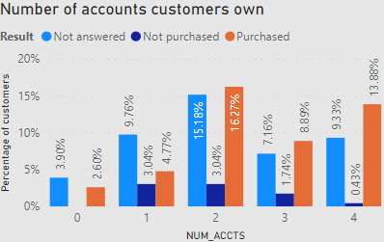
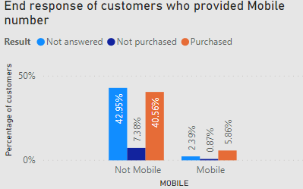
Analysis & Results
Customers’ behaviors

Slide 8
Analysis & Results
55% of customers answered the phone and 84% of them purchased the product if they answered phone
Customers with low and medium income => opt services to optimize their savings and expenditure
younger customers => people start to have plan to save for their retirement
female customers => female customers are expected to have longer life expectancy, spend more for health care and household services than Male customers
people who do not pay rent or own a residence are more likely to answer the call than who pay the rent => more in debt (mortgages or house payment) therefore they may opt for financial service to eliminate their debt, that helps them to avoid high-interest rate which will continue to shrink their wallet

Slide 9
Analysis & Results
people with higher balance in checking accounts and saving accounts prefer to handle finances well for which they are answering our calls and opt for services
customer provide their private contact number; means they are more likely to answer the call as it is accessible
Potential Customers:
Middle aged Females with low to medium income range who have a smaller number of dependents and does not pay rent or own a residence but hold higher balance in checking or saving accounts and have higher number of accounts and provide mobile phone number.

Slide 10
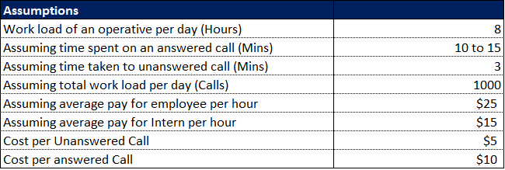
Recommendations
Staff Efficiency Scheduling

Slide 11
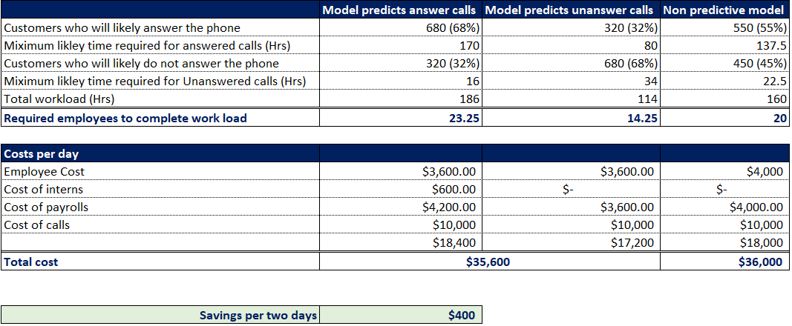
Recommendations
Staff Efficiency Scheduling

Slide 12
Recommendations
Operational process
Sales Revenue
Trust Issues
Further considerations
Call durations, type of product specific information:
Prioritize customers who consume less time, assign the equal workload, proposing incentives for representatives
Usage of Chatbots for FAQs, Live chat,
Representatives must be subject matter experts of certain area, mobile number mandatory in the form
Focusing on potential customer’s needs
And Focusing on demographics of customers
Get safety certifications
And Advertise => raise customers’ awareness and reduce skepticism

Slide 13
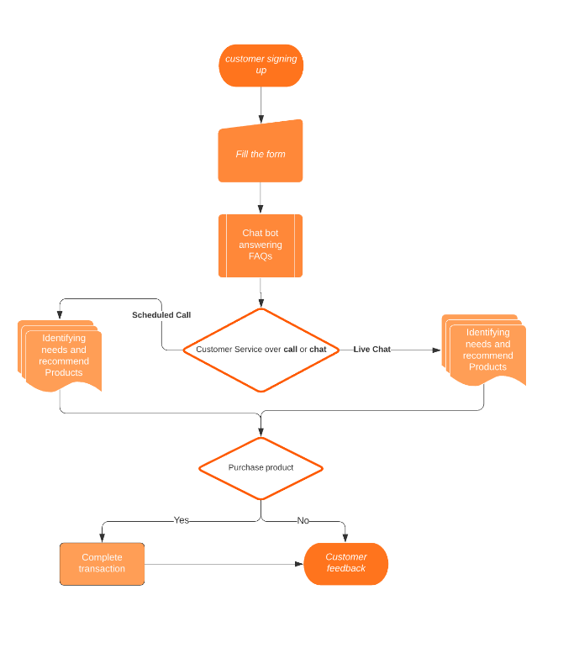
Recommendations
Operational process

Slide 14
Recommendations
Operational process
Sales Revenue
Trust Issues
Further considerations
Call durations, type of product specific information:
Prioritize customers who consume less time, assign the equal workload, proposing incentives for representatives
Usage of Chatbots for FAQs, Live chat,
Representatives must be subject matter experts of certain area, mobile number mandatory in the form
Focusing on potential customer’s needs
And Focusing on demographics of customers
Get safety certifications
And Advertise => raise customers’ awareness and reduce skepticism

Slide 15
Thanks!

